Slide 1
Asking Transformer to Simplification Research Paper
Ganesh Epili (202211022), Mukesh Jha (202211070), Shreya Modi (202218018), Arjun Vankani (202211036)

Slide 2
Problem Formulation
Our Proposed Solution
Problems we faced during reading Research Paper:
Complex Words
Authors use some complex words
Ex:
Complex: Ubiquitous Simpler: Everywhere
Complex: Efficacy Simpler: Effectiveness
Document Redundancy
Ex:
Redundant and Lengthy: In order to ascertain the validity and reliability of the findings, it is necessary to conduct a thorough and comprehensive examination and analysis of the data that has been collected from the participants in the study.
Revised: To validate the findings, conduct a comprehensive analysis of the collected data.
Lexical Simplification: Replace complex words with Simpler words
Abstractive Summarization: Summarize the document to reduce redundancy

Slide 3
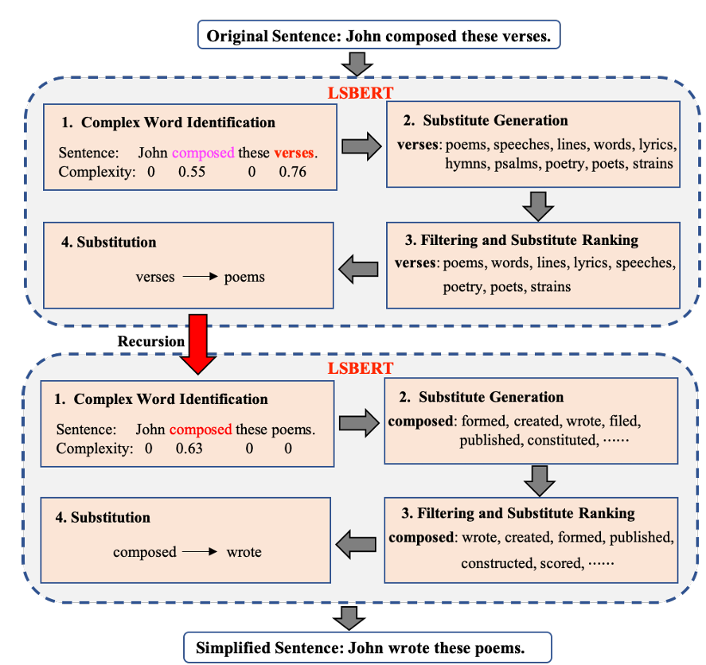
1. Replace Complex Word
Complex Word Identification (CWI): Develop a model to identify complex words in sentences using BiLSTM.
Candidate Generation: Utilize BERT's masked language model to generate potential word candidates.
Simplify with Zipf Values: Calculate Zipf values for each candidate and choose the simplest one.
Qiang, J., Li, Y., Zhu, Y., Yuan, Y., & Wu, X. (2020). LSBert: A Simple Framework for Lexical Simplification. ArXiv. /abs/2006.14939
Image 1: Diagram Showing steps to reduce complex words

Slide 4
Complex Word Identification (CWI)
Data: Uses dataset of 2,000 sentences annotated with binary complexity labels for each word, based on human judgments.
Architecture: Adopts a Bi-LSTM network, takes word embeddings as input and outputs a complexity score for each word.
Objective: Optimized by minimizing the cross-entropy loss between the predicted complexity scores and the gold labels.

Slide 5
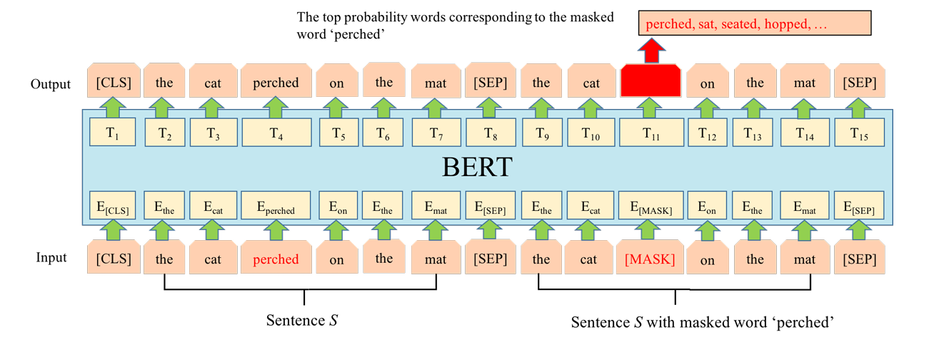
2. Candidate Generation
Fig 2: Substitution generation of LSBert for the target complex word prediction, or cloze task. The input text is ”the cat perched on the mat” with complex word ”perched”. [MASK], [CLS] and [SEP] are thress special symbols in Bert, where [MASK] is used to mask the word, [CLS] is added in front of each input instance and [SEP] is a special separator token.

Slide 6
3. Filtering and Substitute Ranking
Select the best candidates based on Zipf frequency.
Zipf frequency measures how often a word appears in language, indicating familiarity.
Higher Zipf values correspond to more common words, ensuring replacements are likely to be familiar to a broad audience.
Get 10 context-aware candidates word from BERT. Compute their Zipf values.
Sort each candidates based in the greater zipf value.
Replace each complex word with their simpler counterpart.

Slide 7
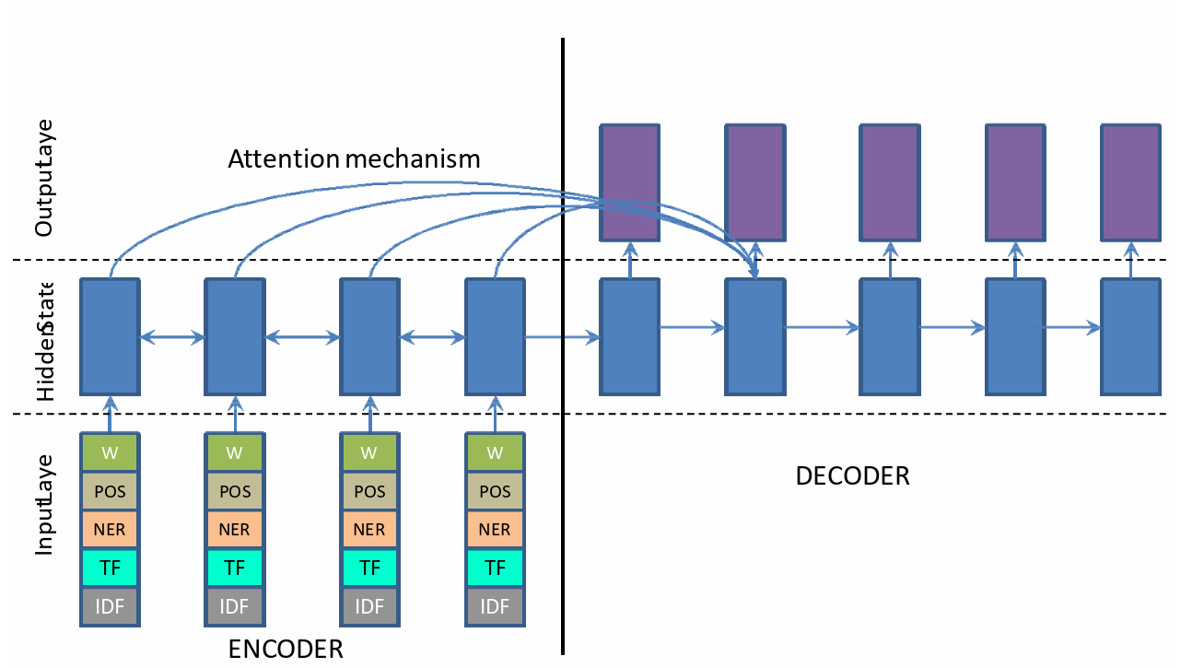
Abstractive Summarization
Dataset: https://huggingface.co/datasets/scientific_papers
Nallapati, R., Zhou, B., Santos, C. N., Gulcehre, C., & Xiang, B. (2016). Abstractive Text Summarization Using Sequence-to-Sequence RNNs and Beyond. ArXiv. /abs/1602.06023

Slide 8
Results
On test set of https://huggingface.co/datasets/scientific_papers we evaluated(500 sentences)
 | ROUGE-1 | Blue | TER
Only Lexical Simplification | 11.3215 | 22.5853 | 82.63
Lexical Simplification + Summarization | 11.8745 | 13.6536 | 81.25

Slide 9
Reference
Nallapati, R., Zhou, B., Santos, C. N., Gulcehre, C., & Xiang, B. (2016). Abstractive Text Summarization Using Sequence-to-Sequence RNNs and Beyond. ArXiv. /abs/1602.06023
Qiang, J., Li, Y., Zhu, Y., Yuan, Y., & Wu, X. (2020). LSBert: A Simple Framework for Lexical Simplification. ArXiv. /abs/2006.14939

Slide 10
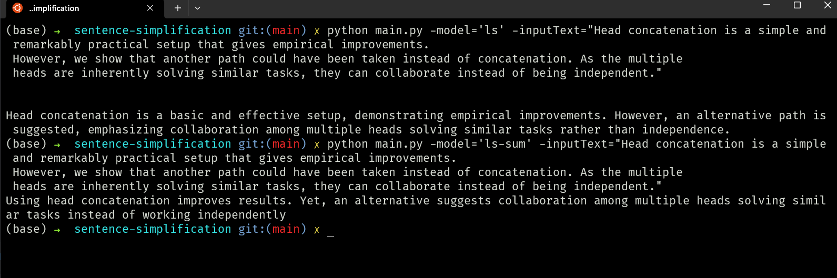
Demo

Slide 11

Demo

